Slide 1


CROP RECOMMENDATION SYSTEM
Presented by Abdul Rehman MSDS-2024-S-11

Slide 2
PROBLEM STATEMENT
Developing a machine learning-based crop recommendation system that analyzes key environmental factors to provide accurate crop suggestions, helping farmers optimize their decisions and increase productivity.

Slide 3

OBJECTIVES
1
Analyze the distribution of attributes to identify patterns and ensure data quality.
2
Develop and integrate new features (e.g., Water Availability Index (WAI) and Temperature-Humidity Index (THI)) to enhance the dataset's predictive power.
3
Build machine learning model to predict crop types and evaluate their performance in terms of accuracy and interpretability.

Slide 4
KEY QUESTIONS
1
How do environmental factors interact and influence the classification of different crops?
2
Can a machine learning model effectively predict crop types based on environmental and soil attributes, and performs best for this dataset?
3
How does the inclusion of engineered features like THI and WAI improve the model's accuracy in predicting crop classifications?

Slide 5


RESEARCH METHODOLOGY
Data Collection
Data Preprocessing
EDA
Model Training
Model Evaluation

Slide 6

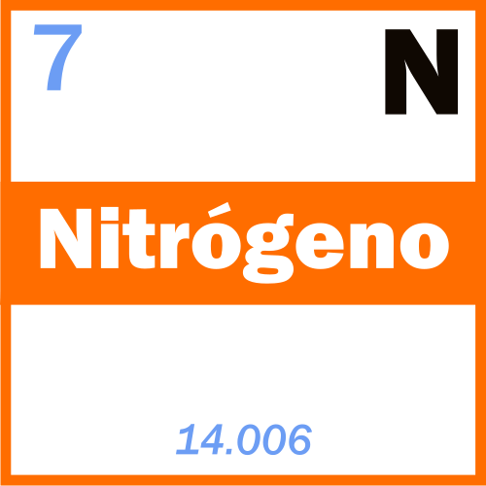
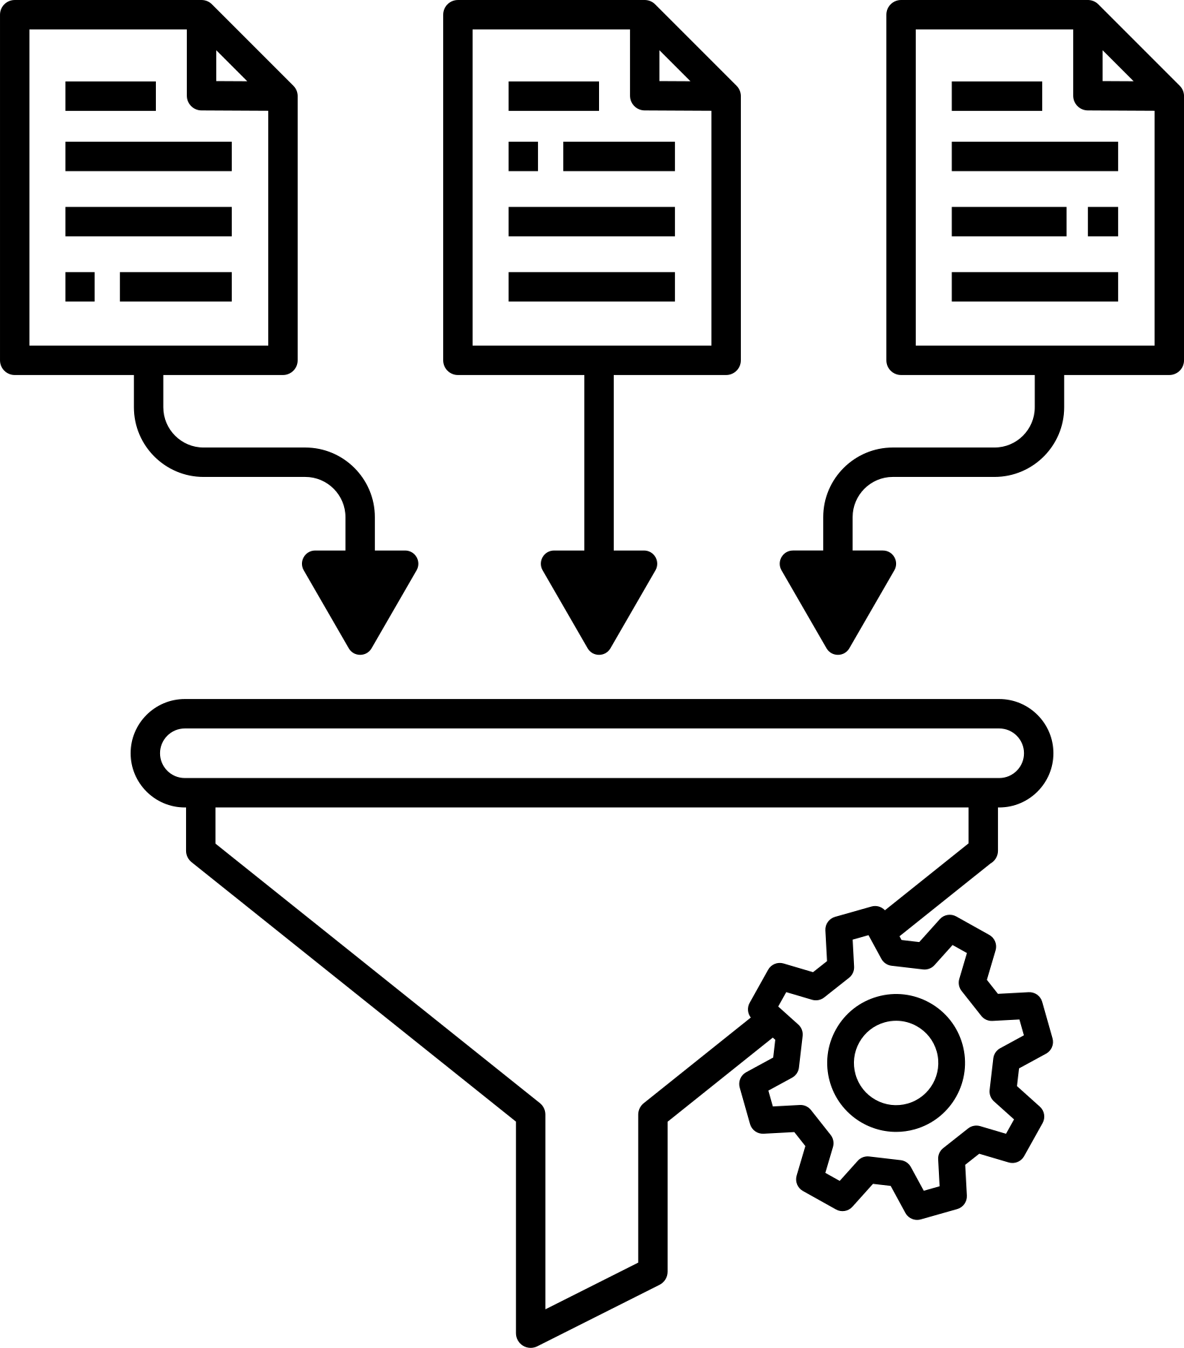



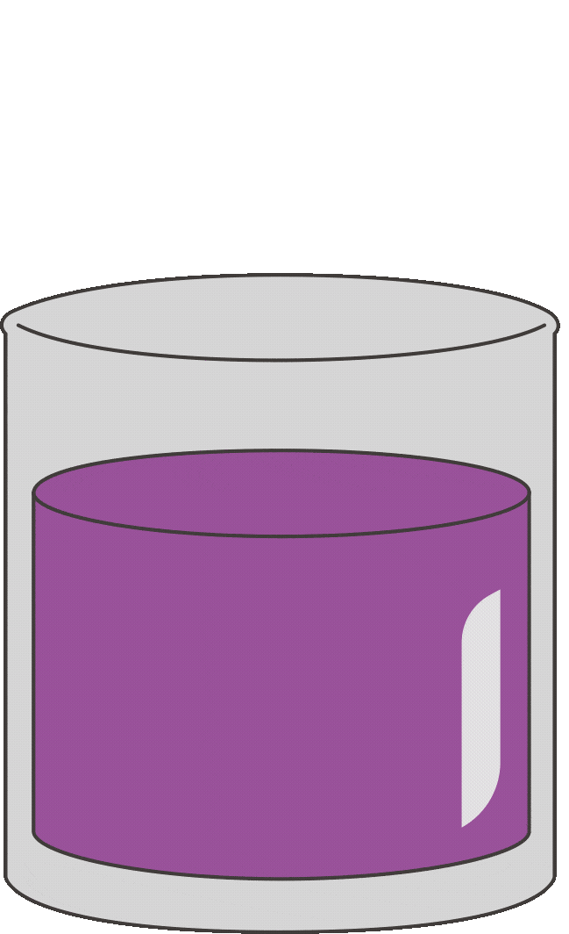






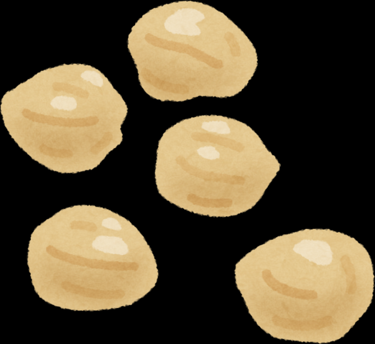

Data Preprocesing
EDA
Training data
Testing data
Decision Making
Model Evaluation
Model training

Slide 7
DATA COLLECTION
Data was sourced from a publicly available GitHub repository, including features like temperature, humidity, pH, and rainfall.

Slide 8
DATA WRANGLING
The dataset was cleaned to remove missing values, ensuring quality inputs for model training but there is no missing and dupliacte values in our dataset.
During preprocessing, the dataset was normalized using min-max scaling to ensure balanced feature contributions in the model. For feature engineering, key indicators like temperature, humidity, rainfall, and pH were refined and adding new features to enhance model accuracy and performance.

Slide 9
FEATURE ENGINEERING
Temperature-Humidity Index (THI): A combination of temperature and humidity two critical climatic factors that directly affect crop growth. It helps quantify the level of heat stress on crops, By integrating THI, the model captures complex interactions between temperature and humidity.
The Water Availability Index (WAI) combines rainfall and humidity into a single metric to measure water sufficiency for crops. This helps assess whether environmental conditions provide enough water for optimal crop growth.

Slide 10
MIN MAX SCALING
MinMax Scaling is a normalization technique that transforms the data to a fixed range, typically between 0 and 1. It helps in scaling all features proportionally so that they contribute equally to the model. This scaling technique was used to ensure that all features have equal influence during model training.

Slide 11
EXPLORATORY DATA ANALYSIS

Slide 12
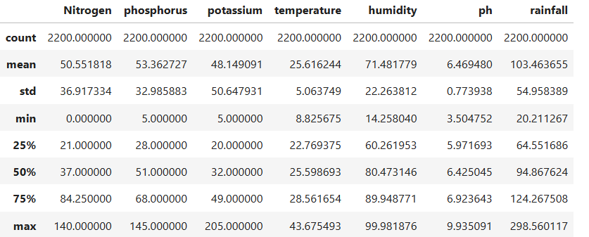
DESCRIPTIVE ANALYSIS

Slide 13
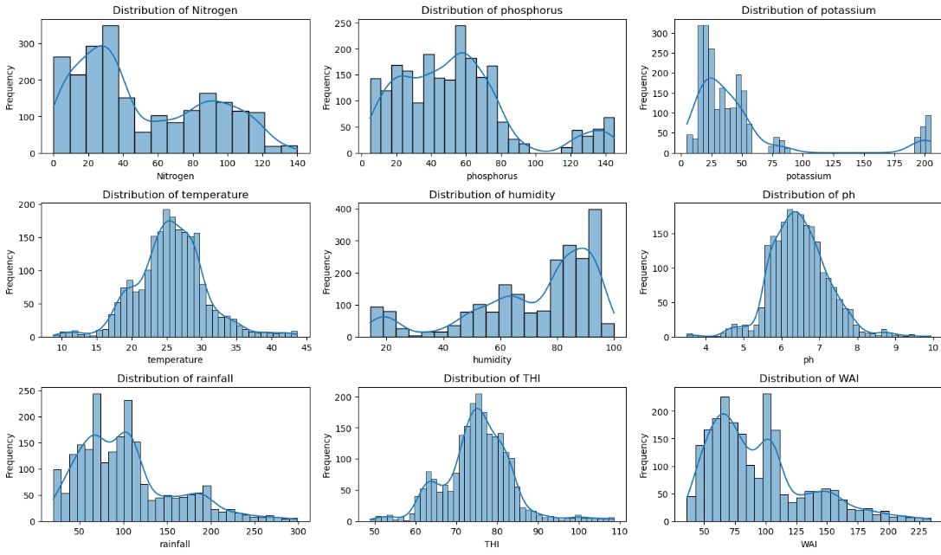
Distribution Plot

Slide 14
Nitrogen : Skewed distribution with most nitrogen values concentrated between 0 and 50.
Phosphorus:Uniform distribution with peaks around 40–60, and fewer data points above 120.
Potassium : Skewed towards lower values, with most data points concentrated below 50.
Temperature : Bell-shaped distribution with most frequent values around 20–25°C, resembling a normal distribution.
Humidity : Peaks significantly at 80–100, with fewer occurrences at moderate values (40–60).

Slide 15
pH : Bell-shaped distribution centered around 6–7, indicating predominantly near-neutral soil pH.
Rainfall :Bi-modal distribution with peaks at 100 and 250, with few data points at very low or high rainfall levels.
Temperature-Humidity Index (THI): Slightly bell-shaped distribution, with most values between 70–90, indicating balanced heat stress conditions.
Water Availability Index (WAI): Peak near 150, with most values between 100–200, indicating moderate water availability

Slide 16
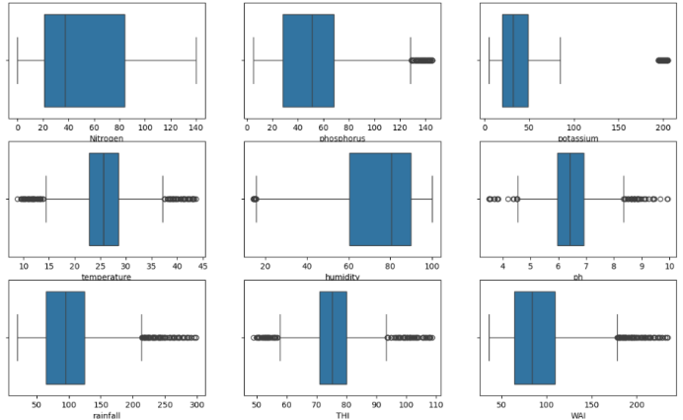
Outlier Detection

Slide 17
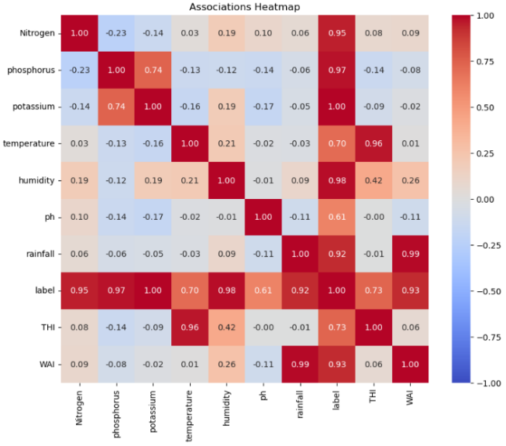

Slide 18
PREDICTIVE ANALYSIS

Slide 19
MODEL TRAINING
The dataset is split into training and testing sets using train_test_split.
The classifier (DecisionTreeClassifier()) is trained on the training data using model.fit(x_train, y_train).
Decision Trees in crop recommendation systems offer clear interpretability, handling both linear and non-linear relationships between environmental factors. They also identify key features influencing crop choices, are robust to outliers, and require minimal data preprocessing.

Slide 20
EVALUATION
Confusion Matrix: It displays how well the model predicted each class
The Classification Report includes precision (relevance of selected items), recall (ability to identify relevant items), and F1-score (balance between precision and recall). It also shows support, the actual number of occurrences for each class in the dataset.

Slide 21
RESULTS
The model performs very well, achieving near-perfect accuracy (98%).
Precision, recall, and F1-scores for each class are also high, indicating good classification for each fruit type (e.g., apple, banana, orange).

Slide 22
Thank You
For your attention

